Slide 1
Banking sector
Theory: Monetary policy
Evolution
New Bank licenses
Measures for Financial inclusion
Banks vs NBFC
All PowerPoint Slides available at Mrunal.org/Download

Slide 2
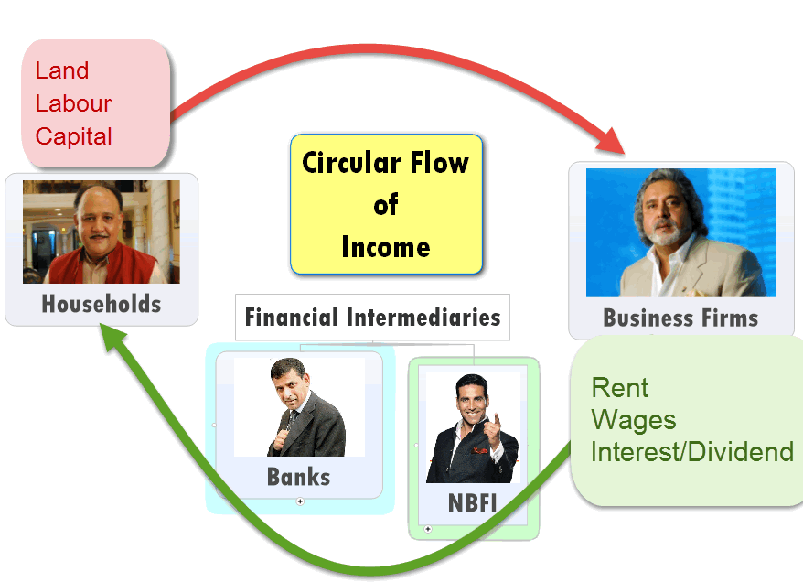
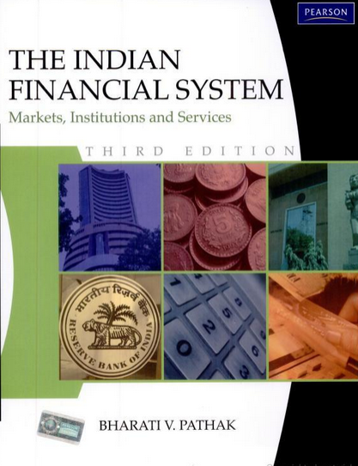
Barter system=> Double coincidence of wants=>Money
Evolution of Banking sector in India
If any discrepancy in these PPTs vs. wiki,Ramesh, Dutt-Sundaram et al that’s bcoz I refer to book for NBFC & Finance topics.
PS: You don’t need to buy or read this book. This is only for ‘disclaimer’.

Slide 3
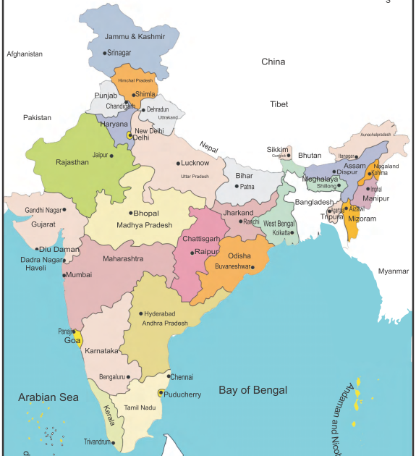

Presidency Banks
East India Co.
Bengal
1806
Bombay
1840
1861: all 3 right to issue currency
Madras
1842

Slide 4
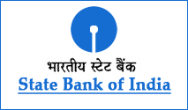
Firangi Banks
East India Co.
Bengal
1806
1921: Imperial Bank of India
Bombay
1840
1955: SBI (Nationalized)
Madras
1842

Slide 5

Indian Banks
Pre-Indp.
1707: Bank of Hindustan
1865: Allahabad Bank
1908: BoB (Gayakwad III)

Slide 6

Bengal region
Desi Banks
UCO-United Commercial ‘43
United Bank of India ‘50

Slide 7

Punjab
Desi Banks
PNB: 1894
Punjab-Sind (’08)
OBC (‘43)

Slide 8
Mumbai
Desi Banks
Bank of India (‘06)
Central Bank of India (‘11)
Union Bank (‘19)
Bank of Maharashtra (‘35)
Dena Bank (‘38)

Slide 9
Karnataka Manglore
Desi Banks
Corporation (06)
Canara Bank (’10)
Syndicate bank (‘28)
Vijaya (‘31)

Slide 10
Andhra Tamilnadu
Desi Banks
Andhra bank: 1923
TN: Indian Bank (‘23); Indian Overseas bank(‘37)

Slide 11
Firangi Banks
Swadeshi Banks
Bombay, Bengal, Madras Presidency=> Imperial Bank’21 =>SBI’55
British Army, Bureaucrats, Judges, merchants
Allahabad Bank, PNB, BoB, Canara
Focus: Foreign trade, Merchants
Local=>Shroff, Moneylenders.
Financial inclusion _____.(high / low)

Slide 12
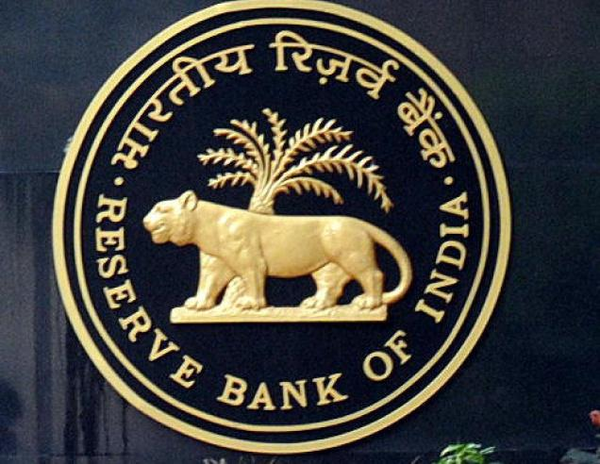
Birth of RBI
Pre-Indp.
By 30s: 1200+ banks
Only company law
30s Great depression =>defaults
1934 RBI
Notes:
n October 24, 1929, the stock market bubble finally burst, as investors began dumping shares en masse. A record 12.9 million shares were traded that day, known as “Black Thursday.”

Slide 13
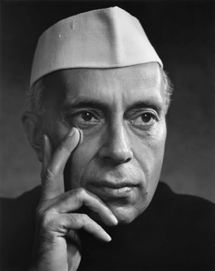
Post-independence
Evolution
SBI, ICICI, PNB, BoB.
Focus: merchant, industrial houses
Branch increase YES
Rural penetration NO
Help in FYP achievement NO
Nexus of industrial houses vs banks.

Slide 14
CEO
Executives
Staff
PROFIT
Board of Directors
Chairman
DIVIDEND
SHARE-HOLDERS

Slide 15
SBI
Nationalization
Three presidential banks
1921: Imperial bank
1955: SBI
Notes:
1959: SBI subsidiaries

Slide 16
Nationalization of Banks
’55 | 1 | Imperial bank (SBI)
’69 | 14 | 50 cr. deposit
’80 | 6 | 200 cr. Andra, Vijaya, Oriental
Financial inclusion:
RRB
Cooperative banks
NABARD

Slide 17
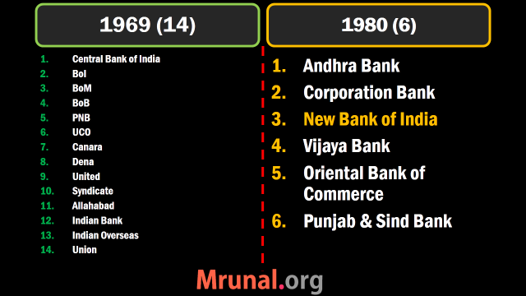

Slide 18
Prelim 2009
Q. In context of independent India's economy, which one of the following was the earlier event to take place?
Nationalization of insurance companies
Nationalization of state bank of India
Enactment of Banking regulation Act
Introduction of first Five year plan.

Slide 19
Mock Question (2009)
Q. In context of independent India's economy, which one of the following was the earlier event to take place?
Nationalization of insurance company: 55-56
Nationalization of state bank of India: 55
Enactment of Banking regulation Act: 49
Introduction of first Five year plan: 51
1. Skip 2. Attempt 3. Mark n Review

Slide 20
Public Sector Banks today
Public sector: (22)
21+ [1 SBI + 5 Asso.] = 27 PSB
iba.org.in/viewmembanks.asp?id=1
P J Nayak Committee (27)
Homework: logo-tag of each bank IF you’re preparing for BANK exams.

Slide 21
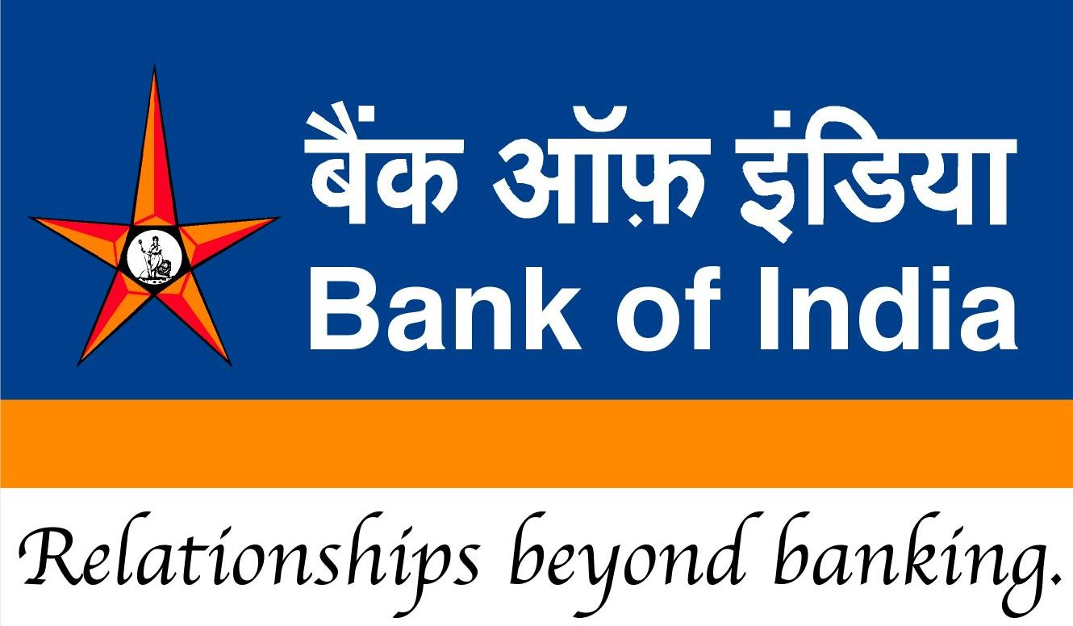
Logo and motto

Slide 22
Evolution of Banking sector
Bank Nationalization: WHY AND HOW?

Slide 23

problems
Nationalization
Administered interest rate
political interference, loan mela=>NPA=>Civil Court.
Trade union, VRS
high reserve requirement: CRR 15%, SLR 40%=>
hard to get loans for business=> BoP crisis

Slide 24
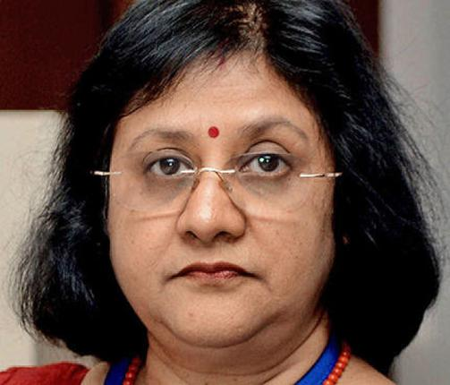

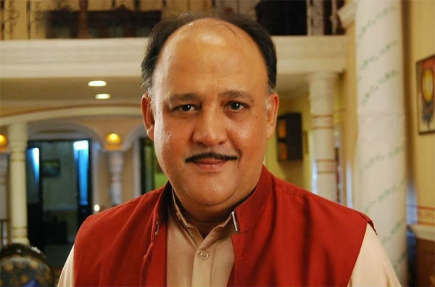



Reserve Ratios
Pay 0-4-9%
Pay 10-15-18%
Depositors
Borrowers
CRR: 15%
SLR: 40%
Total: 55%
CRR: 04%
SLR: 22%
Total: 26%

Slide 25
High reserve ratios
Pre-LPG
High cost of credit (loans)
Business expansion ▼
Job creation ▼
Tax-Collection ▼
Government borrowing: Fiscal deficit ▲
Exports ▼
Current Account Deficit ▲
CRR: 15%
SLR: 40%
Total: 55% of NDTL couldn’t be lended

Slide 26
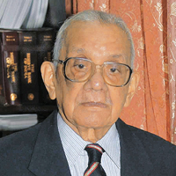
Narsimhan Committee I (GoI)
1991
Ex-RBI Governor M.Narsimhan
Deregulation of interest rate
Benchmark Prime Lending Rate (BPLR)
Base Rate (2010)
Notes:
Remember, RBI does NOT fix the base rate. It has issued broad guidelines to bank as to how they should arrive at the base rate. Thus, individual bank itself fixes its own base rate.
The calculations of the BPLR by various banks was not transparent. In case of BPLR, Banks normally used to take into consideration the factors like cost of funds, administrative costs and a margin over it. However, such parameters were neither disclosed by banks nor were same for all the banks.

Slide 27
Base rate system: SBI 10%
SBI’s | Base rate+ | result
Car loan | 0.75% | 10.75%
Two wheeler | 8.25% | 18.25%
Education (4L) | 3.5% | 13.5%
Home (upto 75L) | 0.15% | 10.15% (10.10%W)
Home (>75L) | 0.30% | 10.30% (10.25%W)
Notes:
Banks cannot lend below Base rate.

Slide 28
Narsimhan Committee I (GoI)
1991
PSL@normal interest rates=> interest subvention
Debt recovery tribunal => 1993 =>SARFAESI 2002 (ref: website)
Liberal Branch expansion policy =>(25% rural requirement)

Slide 29
Narsimhan Committee I (GoI)
1991
Reduce CRR, SLR=>(15,40)=>(4,22)
NBFC regulatory framework
1992=>SBI shares sold. =>GoI ~60%
Private + foreign banks=> 1993 =>2001 =>2013

Slide 30
Bank license 1st Round (10 licenses)
6 Working
4 Closed
ICICI
HDFC
UTI=>Axis (2007)
IDBI (‘64 indirect fin.)
Indus
DCB
Global Trust Bank (2001 scam, OBC)
Bank of Punjab=>Centurion
Centurion =>(HDFC)
Times Bank=> (HDFC)
Guideline: 1993; Operation: 1994-95

Slide 31
Banking sector in British India
Bank nationzation: why, how, shortcomings
Narsimhan 1st : new bank licenses (90s)

Slide 32
Narsimhan Committee II
1998
VRS
Legal reforms for loan recovery. =>SARFAESI 2002
Computerization, electronic fund transfer, legal framework
Payment and Settlement Act=>Retail (ECS, NEFT, Card) + Wholesale (RTGS)
Permit new private /foreign banks.

Slide 33
Bank Licenses 2nd Round
Kotak Mahindra
Yes Bank
Guideline: 2001
Operation: 2003-04

Slide 34
1998: Narsimhan Committee II (GoI)
Before | After
Banks NBFI DFI (Development Financial institutions)- ICICI, IDBI, IFCI etc. | Banks NBFI

Slide 35
New Bank Licenses

Slide 36
New banks 90s-2001
Guideline | Operational | Who?
93 | 94-95 | ICICI HDFC UTI=>Axis (07) IDBI Indus DCB Global Trust Bank (2001 scam, OBC) Bank of Punjab=>Centurion bank Centurian Bank=>(HDFC) Times Bank (HDFC)
01 | 03-04 | Kotak Mahindra Yes Bank

Slide 37
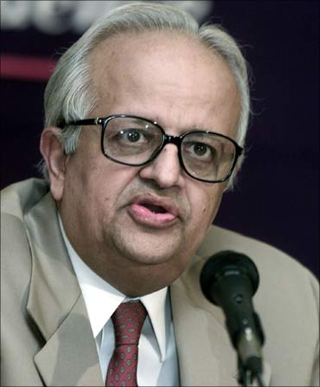
New Bank Licenses
2013
Feb-July 2013: applications sought
Ambani, Birla, Bajaj, Tata, Muthoot, Indian post
Minus 2 (TATA, Videocon)
25 left

Slide 38
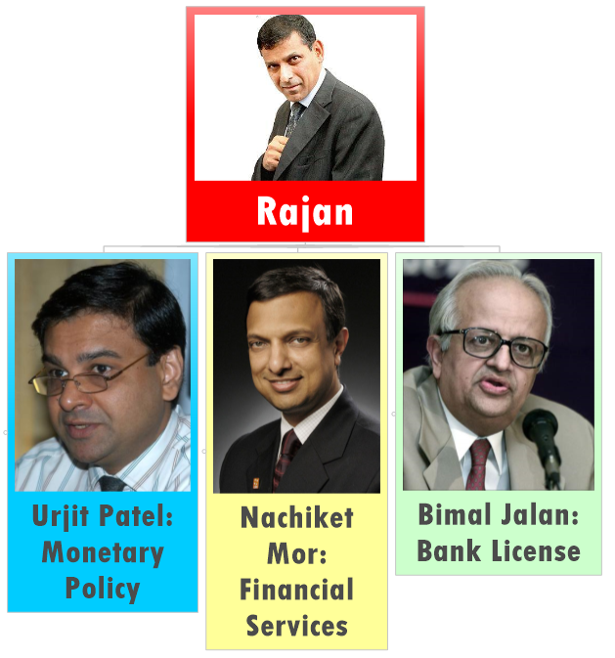
RBI High level advisory Committee, Bimal Jalan
Mahila Bank Sep’13 (public sector BUT NOT Bimal)

Slide 39
New Bank Licenses
2013
Feb 2014: Report submitted
March 2014: EC permission sought
April 2014: In principle approval to two applicants: Bandhan Fin. Service and IDFC

Slide 40
New Bank Licenses
2013
“in principle” approval
Within 18 months
Rs.1000 crore net worth
25% branches in unbanked rural areas.
Then license under Banking Regulation Act, 1949 [Sec.22(1)]

Slide 41

Chandra Shekhar Ghosh
Bandhan
West Bengal
Micro Finance Co.
Boss: Chandra Shekhar Ghosh
Presently borrows from (23%.). But Bank license- can get CASA.
45% branches in rural already.
Intl. finance corporation (IFC) and Singapore GIC=> 1600 crore funding => RBI final proposal
Notes:
24th January

Slide 42

Rajiv Lall
IDFC
Infrastructure Development and Financial Corporation
Mumbai, NBFC
Power project, infra. Loans
2100 cr., but rural presence low.
De-merger: IDFC ltd + IDFC Bank (RBI approved, Jan 2015)

Slide 43
Who did not get license?
Kumar Mangalam Birla: Coal block
Anil Ambani: 2G case
India post: Bimal Jalan: consider separately with Govt. consultation
Notes:
Post office=>Five pillars=>

Slide 44
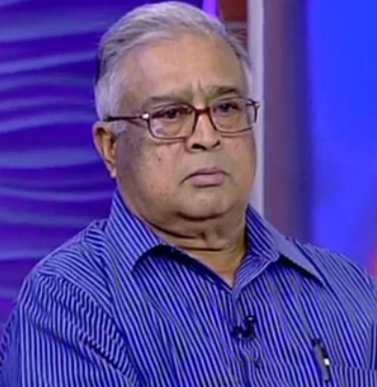
India Post TSR Subramanian
Dec-2014
Communication ministry
TSR Subramanium panel for leveraging post Office network
bank should be setup as separate pillar
Banking
Insurance
E-Commerce

Slide 45
Evolution
Nationalization
Narsimhan-I and II
Private Bank licenses (Bandhan-IDFC)
BMB

Slide 46
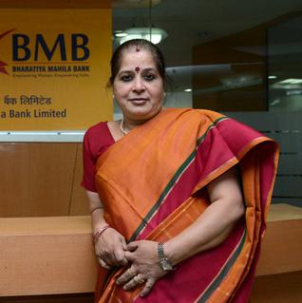
Mahila Bank (2013-14)
BMB
Budget 2013; 1000 crore Rs. (100% State Owned)
MBN Rao Panel blue print (Canara)
Nothing new: 80s Pak, Tanzania 2009
Not new even in India- already urban cooperative banks for women

Slide 47
Mahila Bank (2013-14)
BMB
Sept. License. Indira Gandhi’s b’day (November 19)
HQ Delhi but launched from Mumbai due to model code of conduct.

Slide 48
Mahila Bank (2013-14)
BMB
Usha Anantha-Subramanian
BoD=all women.
Staff, deposit= male + female; BoB, PNB deputation.
Loan => predominantly to women.
loans up to Rs 1 crore without collateral

Slide 49
Mahila Bank (2013-14)
BMB
loans up to Rs 1 crore without collateral
small home-based catering businesses
education loans
kitchen loans

Slide 50
Mahila Bank (2013-14)
BMB
Skill development, financial literacy among women.
Most banks use Finacle by Infosys.
BMB: Core Banking Software by FIS (American Co.)

Slide 51
Interest Rates
BMB
PSB: 4%
BMB: 4.5%; (1 lakh+) 5%
Kotak: 6%
Yes Bank: 8%

Slide 52
Mahila Bank TARGET
BMB
25% branches in unbanked rural areas.
By March 2014: 25 branches
By 2020: 700+ branches; 60k cr business

Slide 53
Mock Question
Who Among the following is the chairman of Bharatiya Mahila Bank?
Arundhati Bhattacharya
Aruna Bahuguna
Shikha Sharma
Usha Ananthasubramanium

Slide 54
2TF: find correct?
Bharatiya Mahila Bank is owned by a consortium of Government of India, NABARD and financial institutions.
For the first three years, Bharatiya Mahila bank will be exempted from CRR and SLR requirements.
Both A and B
Neither A nor B

Slide 55
Assertion reasoning
(A) Bharatiya Mahila Bank will bring down the gender divide in financial inclusion.
(R) Bharatiya Mahila bank will cater only female depositors and borrowers.
Options
Both the statements are individually true and Statement R is the correct explanation of Statement A.
Both the statements are individually true but Statement R is not the correct explanation of Statement A.
Statement A is true but Statement R is false.
Statement A is false but Statement R is true.

Slide 56
3TF
They offers higher interest rates to female depositors over male depositors.
The loan interest rates in Bharatiya Mahila bank, are decided by government of India.
Government has provided the initial capital in this bank from Nirbhaya Fund.
Correct statements
Only 1 and 3
Only 2 and 3
only 1 and 2
None of Above

Slide 57
Interview
Bharatiya Mahila Bank is a mere symbolic exercise for feel good publicity. Do you agree? Yes/No and Why?

Slide 58
Bharatiya Mahila Bank (2013)-Anti points
SBI, PNB, BoB better suited, Govt. already majority shareholder.
25% rural branching: duplication of effort.
Higher Staff deputation
In the first phase focus on state capitals and UT.
4.5%/5% interest – pan India presence.
Overall a Tokenism/symbol but not substance.

Slide 59
Banking evolution
Bank nationalization and associated problems
Narsimhan Committee
Banking licenses -3 rounds
BMB, Bimal Jalan: Bandhan, IDFC

Slide 60
What is financial inclusion?
1.BANKING | Savings & payment-through branches, ATM, cheques, e-transfer
2.CREDIT | Loans at affordable interest rates.
3.INVESTMENT | mutual funds, pension plans, child investment plans etc.
4.INSURANCE | Life insurance and non-life (general) insurance.

Slide 61
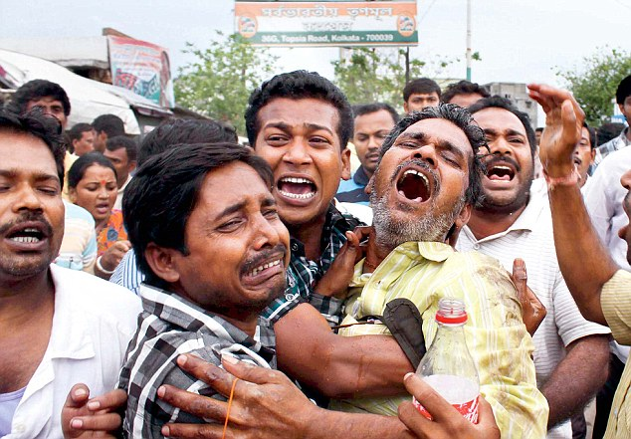
If absent
Financial incl.
Unforeseen circumstances
Child Labour, human trafficking, prostitution, crimes
Money lender- debt trap
Ponzi scheme, MLM, Saradha Chit fund

Slide 62

If present
Financial incl.
Savings into investment
Japan, S.Korea, USA
Social harmony, women Empowerment
E-Payment: Cashless subsidies, payments, salaries: Rs.1 lakh cr (Mckinley study)

Slide 63
WHY?
Jan Dhan
Fin.inclusion attempts in past:
Nationalization
RRB, Coop banks
BCA
Swabhiman, NPS-Swavlamban
MFI (24%)
No-frills account
25% rural branch rule
BMB, Bandhan, IDFC.

Slide 64
Present scenario
Fin.Inclusion
Still 49% families- no account;
55% rural Dalits borrow from money lenders @34% rate.

Slide 65
WHY?
Jan Dhan
Dept of Fin services. 15/08/14; 7.5 cr families in 1 year;
Increased to 10 crore families in the year => 11.5 opened
6 pillars strategy

Slide 66
SIX PILLARS PHASE-1 2014-15
Jan Dhan
Sub-service area to cover 1000-1500 families within 5 kms distance
Each family 1 account, rupay debit card, 1 lakh accident cover, 5k overdraft if good credit history.
Fin.literacy campaign;
Notes:
up to 2 times Net Monthly Salary, Overdraft limit set up on the existing CSP account, Overdraft amount repayable in 6 EMIs

Slide 67
SIX PILLARS PHASE-2 2015-18
Jan Dhan
Credit guarantee fund to cover losses
sell micro insurance product
DBT

Slide 68
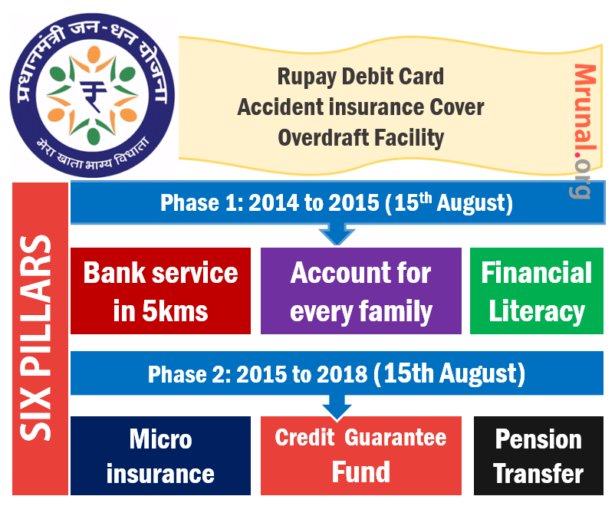
Notes:
LOGO remind

Slide 69
CRITICM
Jan Dhan
Insurance cover only if rupay card used /45 days. (NPCL)
BCA model 2% commission, misconducts by RBI report. 47% untraceable.
Hawala via smurfing (sending money overseas in small units) and money mules

Slide 70
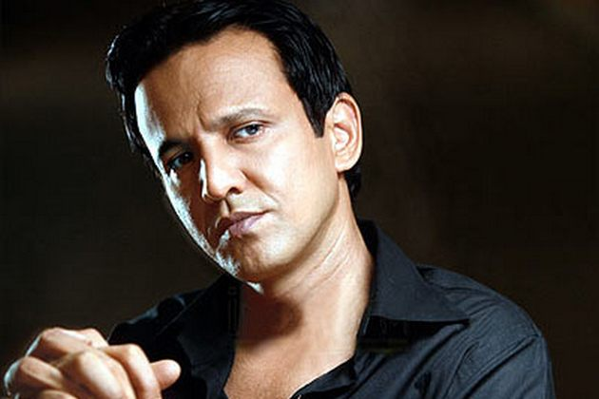


Hawala Operators
30,600
30,000

Slide 71
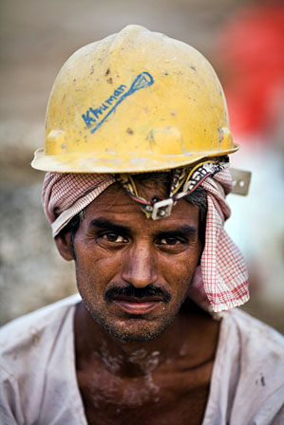
Hawala Operators
10000
10000
10000
30,600

Slide 72
Jan Dhan
http://mrunal.org/2014/10/banking-pm-jan-dhan-yojana-account-salient-features-benefits-limitations-criticism.html
Minute details unnecessary for CSAT for example- 30k additional life insurance cover if opened before 26th Jan 2015

Slide 73
Rupay card
National Payments Corporation of India (NPCI)
Cheque Truncation System (CTS)
Aadhaar Enabled Payment System (AEPS)

Slide 74
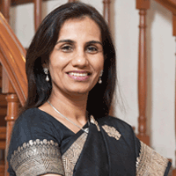


Merchant
Can’t have world wide reach
Duplication of effort
Merchant
Merchant
Credit card, Debit card

Slide 75
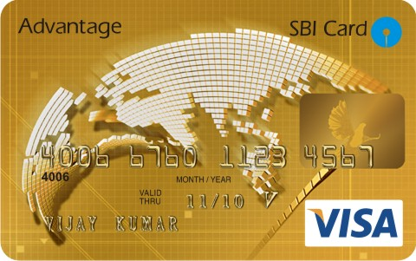
Debit card
Credit Card
Merchant
Mastercard
Visacard
Maestro
Payment gateways
300 cr./ year
Client

Slide 76
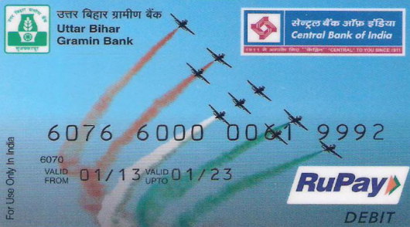
ATM/Debit
card
RuPay
Merchant
300 cr./ year
40% less
Client

Slide 77
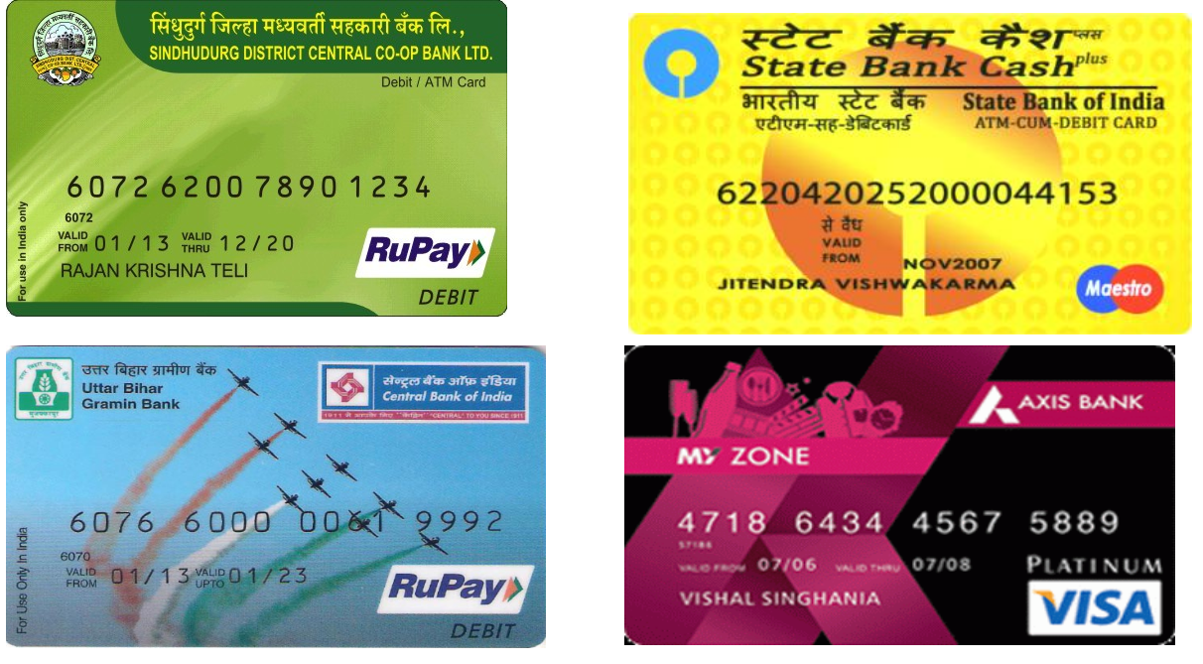

Slide 78
RuPay Card
Mastercard, Visacard, China’s Union Pay
Rupay 7th Payment gateway in world
3 channel: ATM, PoS, Online
Punjab: prepaid cards by milk/grain procurement agencies
Railways: Pre-paid RuPay card (tickets)

Slide 79

1 lakh
Accident
30k
Life insurance
Why 45 days use?
RuPay (NPCI)
Pays premium
Government pays
premium
Union Government employees,
income tax payers not eligible

Slide 80
Banking sector evolution, Bank licenses
Financial inclusion: meaning and importance
Jan Dhan Yojana
Rupay card
Small banks, Payment banks
Kisan Vikas Patra

Slide 81
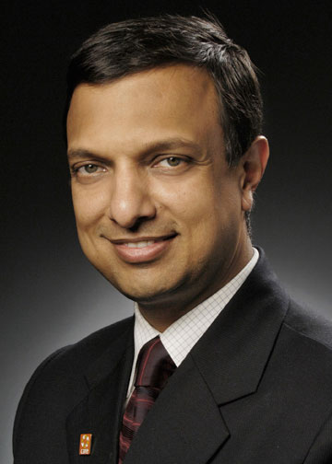
NACHIKET 6 points | Vision Statement
Bank account | A UEBA by 1/1/2016
Access to bank | 15 minutes walking distance (400) Payment Banks
Easy loans | PSL 50%
investment | Wholesale Banks 1/1/16 Broker model, Cross-KYC
insurance
consumer rights | (FRA)
Notes:
Universal electronic bank account

Slide 82
Small banks and Payment banks
Minimum Capital required 100 crores. (Regular bank license 500 Crore).
FDI limits, voting rights similar to regular commercial bank like SBI, PNB, BoB, ICICI.
Deadline to apply: 16th January 2015 2nd February => External Committee screening
large industrial and business houses……X

Slide 83
Small banks
differentiated
Deposit, loan, small area
Small farmers, MSME, unorganized sector
MFI, NBFC can convert
Even individual with 10 years experience in bank/cooperatives
25% rural branching
50% loans to MSME

Slide 84
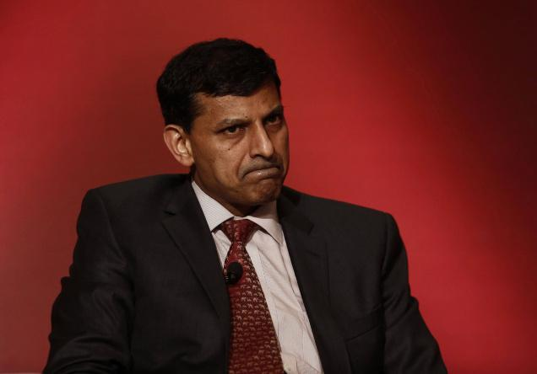
Clarification
Small banks
Deadline extended to 2nd Feb
PSL 40% norm – comply in 3 years
Cooperative bank can’t apply
NRI can apply
Cluster preference: North East
Can’t setup subsidiaries
can appoint BCA. But can’t become BCA of other bank

Slide 85
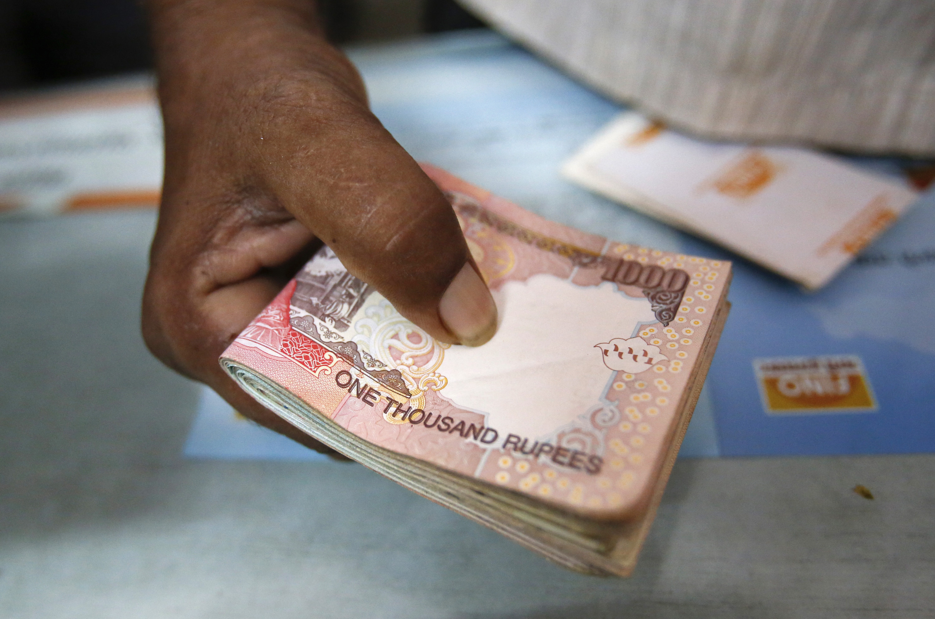
Payment Banks
differentiated
Only CASA, Net banking, prepaid cards
FD/ Loan….X=> G.Sec
Payment, remittance for poors, migrants, unorganized
Max balance Rs.1lakh/customer
http://mrunal.org/2014/12/banking-rrb-amendment-bill-regional-rural-banks.html

Slide 86
Small savings and KVP
Post office deposits (1873)
Savings certificates (1959)
National Small Savings Cert (NSC)
KVP (minimum Rs.100. New Rs.1000)
Indira Vikas patra
Social security schemes
PPF (1968)
Senior citizen savings scheme

Slide 87
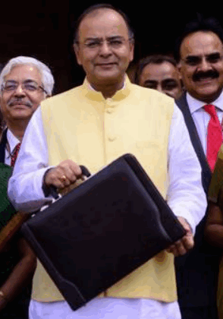
Kisan Vikas Patra
Directorate Small savings, via post office
Money in farmer welfare schemes
Doubles money in ~8 years
2011: Shaymla Gopinath Committee
KVP used for money laundering
Banned
Budget-2014: announced
Nov. 2014: re-introduce
Notes:
Via post office=> poor households

Slide 88
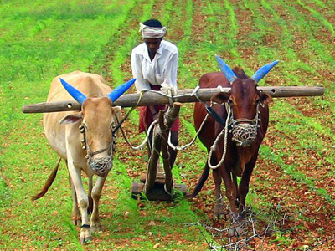
Salient features
KVP
1k to 50k denomination
Double @100 months (8 years and 4 months)
id-address proof needed
To purchase
To transfer
PAN card if 50k ore more
Source of income if 10L or more

Slide 89
KVP
http://mrunal.org/2014/12/kisan-vikas-patra-kvp-features-money-laundering-black-money-tax-benefit.html
Memorize Salient features and Solve MCQs @bottom of that article.

Slide 90
Banking sector evolution, Bank licenses
Financial inclusion: meaning and importance
Jan Dhan Yojana
Rupay card
Small banks, Payment banks
Kisan Vikas Patra

